Slide 1

Machine Learning Operations (MLOps) Overview, Definition, Architecture and Implementation
Abolfazl Yarian
Spring 2023

Slide 2
Outline
Introduction
Open-source tools
MLOps definition
1
3
5
2
4
6
Data science
Overview
Architecture
References

Slide 3
Data science steps for ML
Data extraction
Data analysis
Data preparation
Data cleaning
Data splitting
Transformation and feature engineering

Slide 4
Data science steps for ML
Model training
Implement different algorithm
Hyperparameter tuning
Model evaluation/validation
Model serving
Microservices
Edge device
Model monitoring

Slide 5
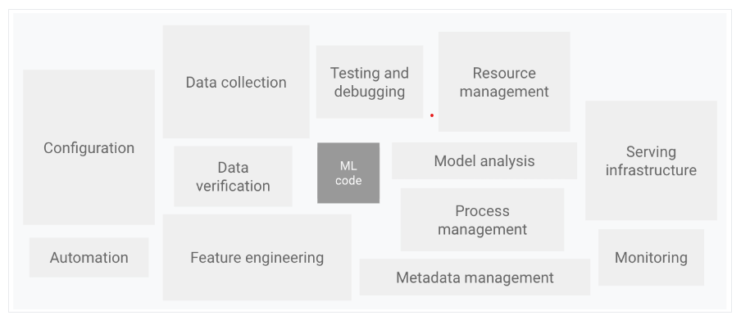

Slide 6
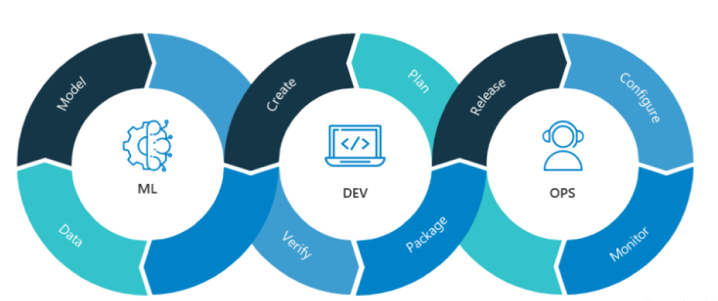
MLOps
MLOps (Machine Learning Operations) refers to the practice of applying DevOps (Development Operations) principles to the machine learning workflow. It involves a set of processes, tools, and techniques to build, deploy, monitor, and manage machine learning models in production environments

Slide 7
MLOps
MLOps manages and automates the end-to-end lifecycle of machine learning models.
Combines DevOps and data science to streamline development, deployment, and monitoring.
Improves collaboration, efficiency, and scalability by standardizing tools, processes, and infrastructure.
Enables continuous integration and delivery, ensuring reliability, security, and performance in production.
Involves monitoring, testing, and updating ML models to remain accurate and relevant.
Accelerates innovation, reduces costs, and improves customer satisfaction.

Slide 8
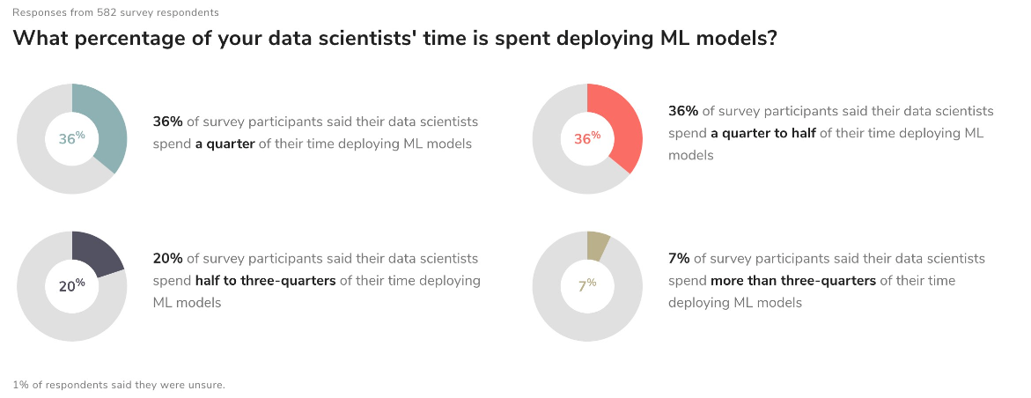

Slide 9
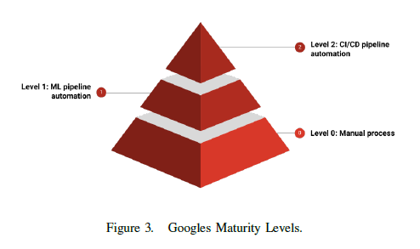
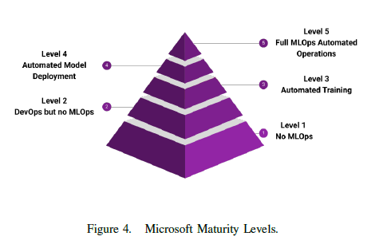



MLOps Maturity Levels

Slide 10
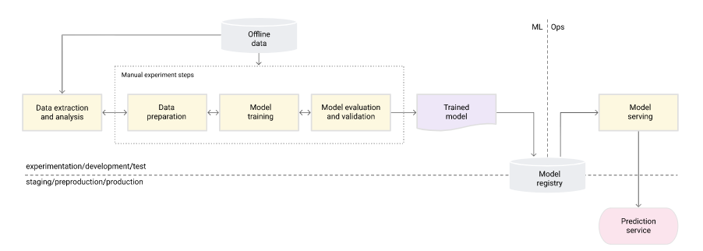
MLOps level 0: Manual process
what is TSD and TSR ?
Definition
Structure
Camera based
LIDAR based

Slide 11
Characteristics
Manual, script-driven, and interactive process
Disconnection between ML and operations
Infrequent release iterations
No CI/CD
Deployment refers to the prediction service
Lack of active performance monitoring

Slide 12
Challenges
Maintain model’s accuracy in production
Actively monitor the quality of your model in production
Frequently retrain your production models
Continuously experiment with new implementations to produce the model
Set up CT/CI/CD to rapidly test, build and deploy new implementation of the ML pipeline

Slide 13
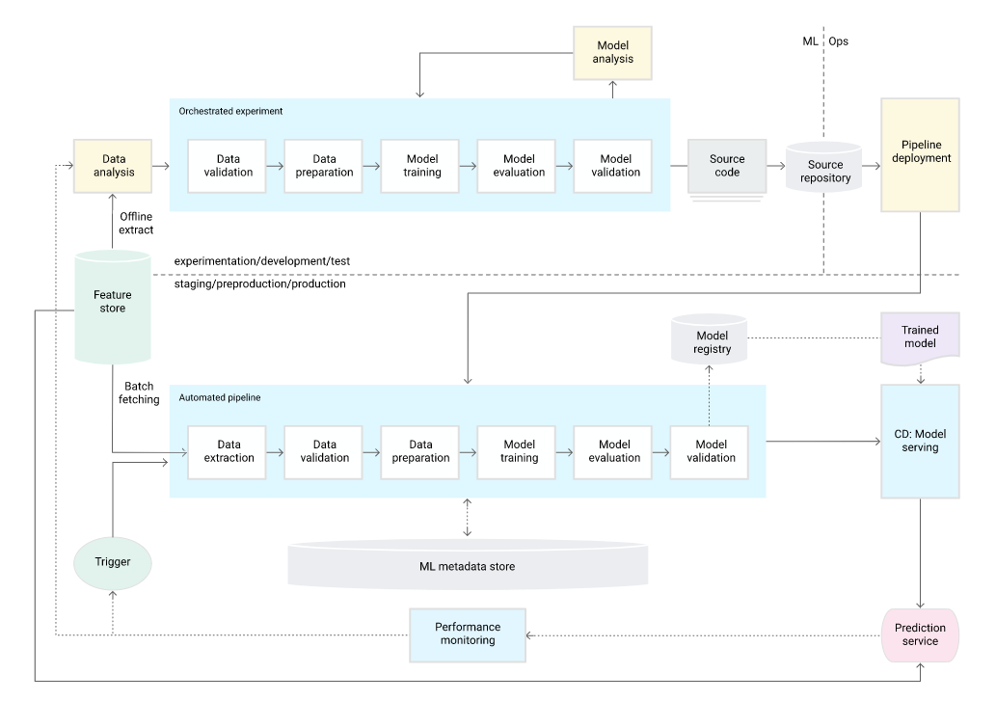
MLOps level 1: ML pipeline automation(CT)

Slide 14
Data validation
Data schema skews (stop)
Unexpected features
Unexpected values
Lack of all expected features
Data value skew (retrain)

Slide 15
Model validation (offline)
Evaluate predictive quality on test dataset
Compare with current model performance
Check for consistency across data segments
Test for deployment and infrastructure compatibility
Conduct online validation through canary or A/B testing

Slide 16
Feature store
Discover and reuse existing feature sets to avoid duplication
Serve up-to-date feature values from the feature store.
Use the feature store for experimentation, CT, and online serving to avoid training-serving skew.
avoid training-serving skew for:
Experimentation (offline)
continuous training
Online prediction

Slide 17
Metadata management
Record pipeline versions, timestamps, and executor for lineage, reproducibility, and debugging
Store parameter arguments passed to the pipeline
Store pointers to the artifacts produced by each step of the pipeline
Store pointers to previous models and evaluation metrics for comparison

Slide 18
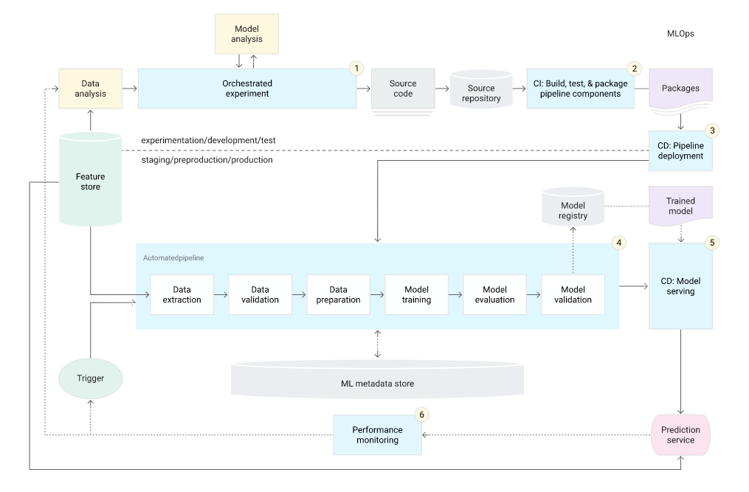
MLOps level 2: CI/CD pipeline automation

Slide 19
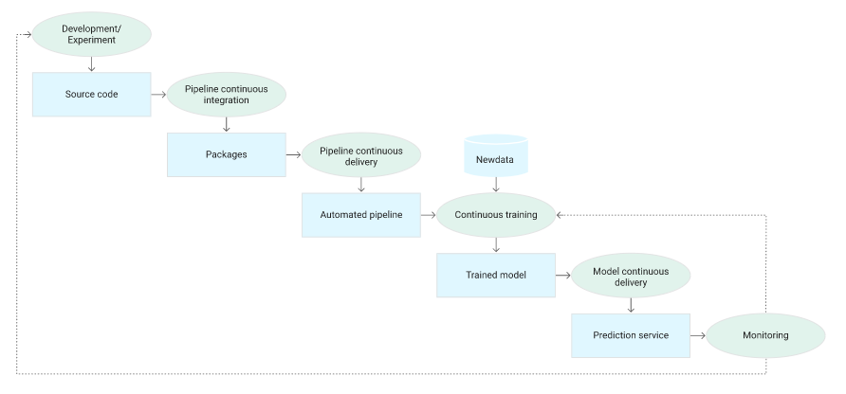
Characteristics
Development and experimentation
Pipeline continuous integration
Pipeline continuous delivery/deployment
Automated triggering
Model continuous delivery
Monitoring

Slide 20
Continuous integration
Unit tests for feature engineering and model methods in implementation
Tests for model convergence and avoiding NaN values
Testing that each component in the pipeline produces the expected artifacts
Testing integration between pipeline components.

Slide 21
Continuous delivery
Verify the compatibility of the model with the target infrastructure before deployment
Test the prediction service by calling the service API with expected inputs
Test prediction service performance by load testing to capture metrics such as QPS and model latency
Validate data for retraining or batch prediction
Verify that models meet predictive performance targets before deployment
Automate deployment to a test environment triggered by code push to development branch

Slide 22
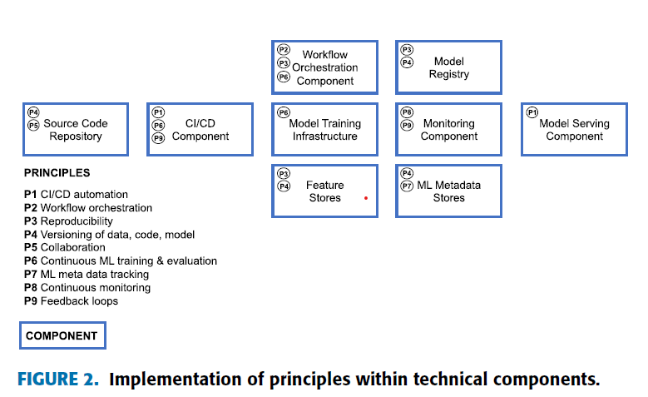
Principles & Technical Components

Slide 23
Principles
P1 CI/CD automation: Build, Test, Delivery, Deployment
fast feedback to developers regarding the success or failure of certain steps
P2 Workflow orchestration (containerization)
coordinates the tasks of an ML workflow pipeline according to DAGs (tasks and dependencies)
P3 Reproducibility
reproduce an ML experiment and obtain the exact same results
P4 Versioning: data, model, code
reproduce and traceability
P5 Collaboration:
possibility of work collaboratively on data, model, and code

Slide 24
Principles
P6 Continuous ML training (CT) & evaluation:
Periodic retraining of the ML model based on new feature data
Assess the change in model quality
Managing costs of retraining:
Update frequency (e.g. daily vs. weekly)
Online learning in large scale web application
P7 ML metadata tracking/logging:
Training job iteration (e.g. training code and time, duration)
Model specific metadata (e.g. used parameters and resulting performance metrics)

Slide 25
Principles
P8 Continuous monitoring
periodic assessment of data, model, code, infrastructure resources, and model serving performance (e.g., prediction accuracy)
P9 Feedback loops
the monitoring component to the scheduler to enable the retraining
quality assessment step into the development or engineering process

Slide 26
Technical components
C1 CI/CD Component (P1, P6, P9)
Jenkins, GitLab CI/CD
C2 Source Code Repository (P4, P5)
GitLab, GitHub, FastDS, DagsHub
C3 Workflow Orchestration Component (P2, P3, P6)
Apache Airflow, Kubeflow,
AWS SageMaker Piplines, Azure Pipline

Slide 27
Technical components
C4 Feature Store System (P3, P4)
Feast, Hopswork, Tecton, Gojek’s Feast
AWS Feature Store
Central storage of commonly used features
Two databases configured:
Offline feature store to serve features with normal latency for experimentation
Online feature store to serve features with low latency for predictions in production
C5 Model training Infrastructure (P6)
Kubernetes, Red Hat OpenShift
CPU, RAM, GPU
Distributed or non-distributed

Slide 28
Technical components
C6 Model Registry (P3, P4)
Store trained ML models with their metadata
MLFlow, ModelDB
AWS SageMaker Model Registry, Azure Model Registry, Neptune.ai
C7 ML Metadata Stores (P4, P7)
Kubeflow pipelines,
AWS SageMaker Pipelines, Azure ML

Slide 29
Technical components
C8 Model Serving Component (P1) ?????
KServing of Kubeflow, Tensorflow Serving, Seldon
Azure ML REST API, AWS SageMaker Endpoints
online inference for real-time predictions
Batch inference for predictions using large volumes of input data
Use Kubernetes and docker technology to container the ML model
C9 Monitoring Component (P8, P9)
Prometheus with Grafana, Kubeflow, Mlflow, ELK stack
AWS SageMaker model monitor
continuous monitoring of:
the model serving performance (e.g., prediction accuracy)
the ML infrastructure, CI/CD, and orchestration

Slide 30
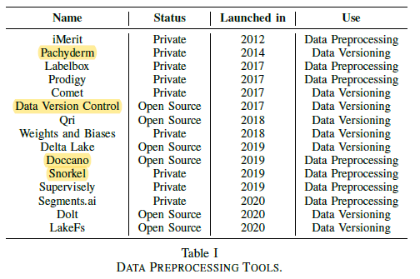
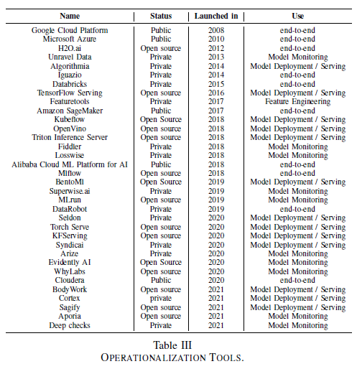
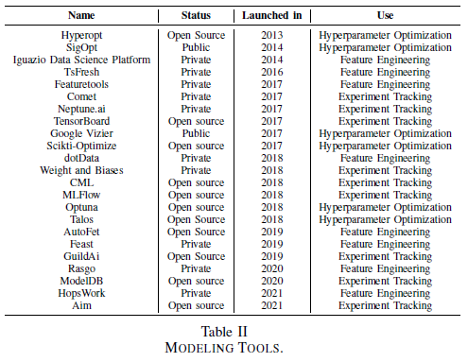
Tools

Slide 31
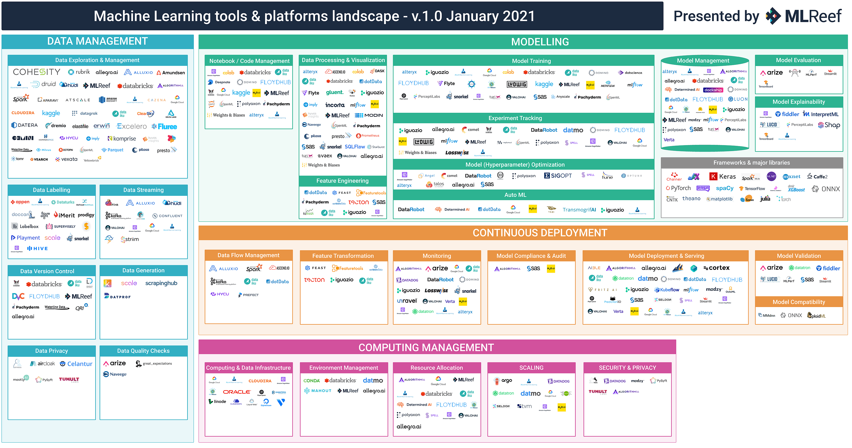

Slide 32
Roles
R1 Business Stakeholder
Define business goal
R2 Solution Architect
Design the architecture and define the technologies
R3 Data Scientist
Translate business problem into an ML problem
model engineering (best-performing algorithm + hyperparameter)

Slide 33
Roles
R4 Data Engineer
Build up and manage data and feature engineering pipelines
proper data ingestion to the databases of the feature store system
R5 Software Engineer
Apply software design patterns
widely accepted coding guidelines
R6 DevOps Engineer
CI/CD automation
ML workflow orchestration
model deployment to production
monitoring

Slide 34
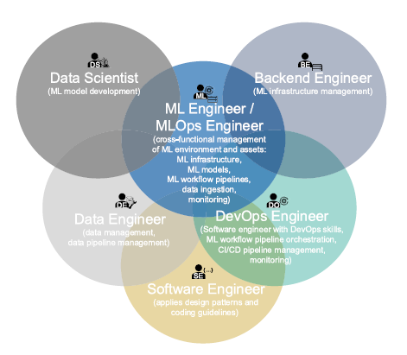
Roles
R7 ML/MLOps Engineer:
build up and operate the ML infrastructure
manage the automated ML workflow pipelines
model deployment to production
monitor model and ML infrastructure

Slide 35
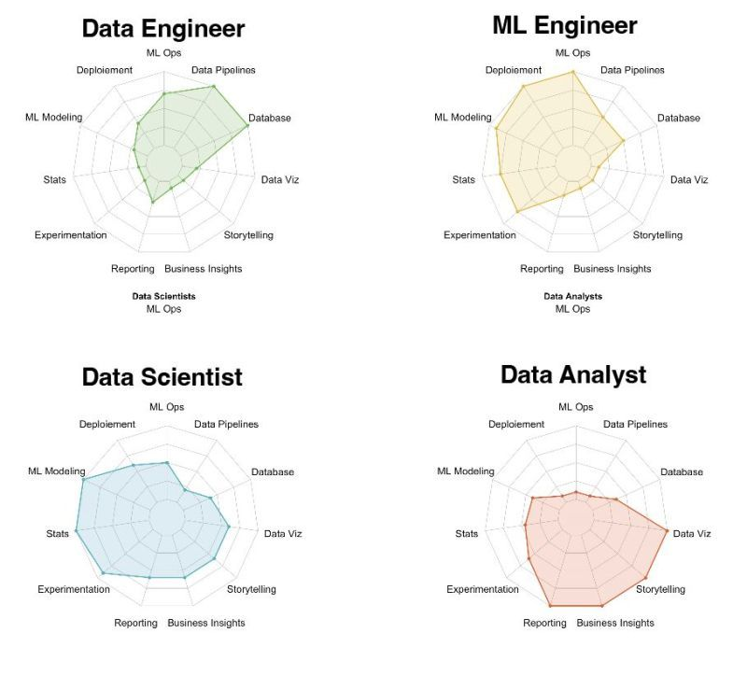

Slide 36
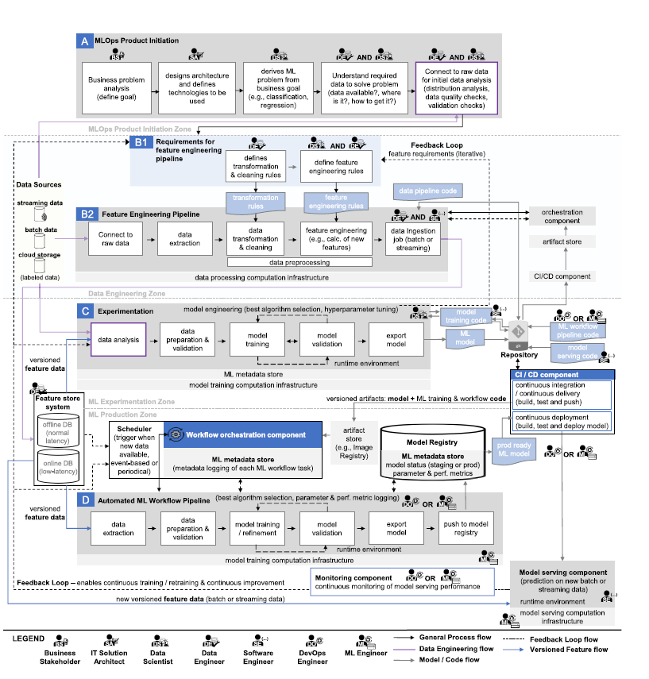
Architecture and Workflow

Slide 37
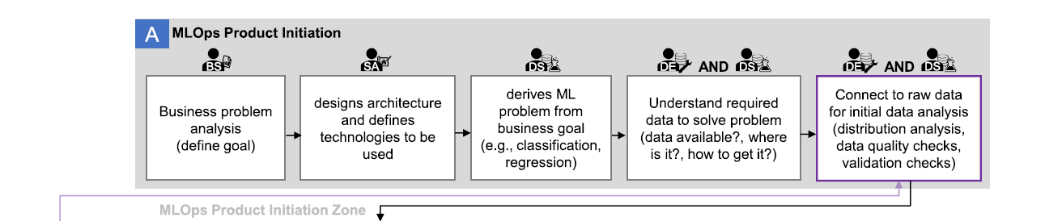
(A) MLOps Product Initiation
Data Source
B1: Requirements for feature engineering pipeline

Slide 38
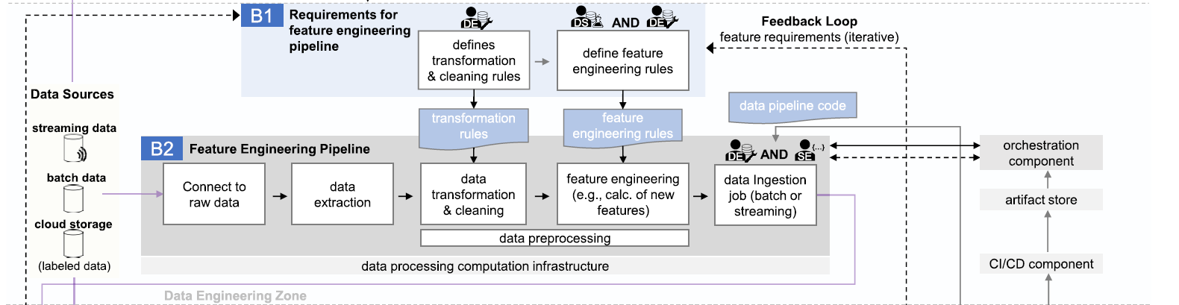
(B) Feature Engineering Pipeline
A: initial data analysis
C: experimentation
C: experimentation
Repository

Slide 39
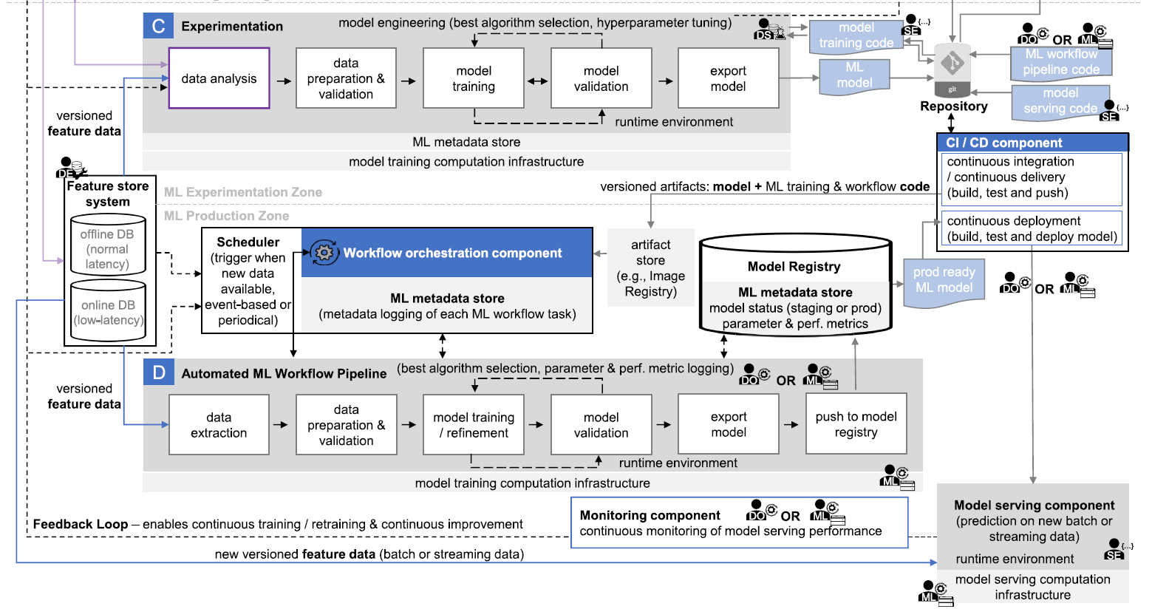
(C,D) Experimentation & Automated ML Workflow Pipeline
B1: Requirements for feature engineering pipeline

Slide 41
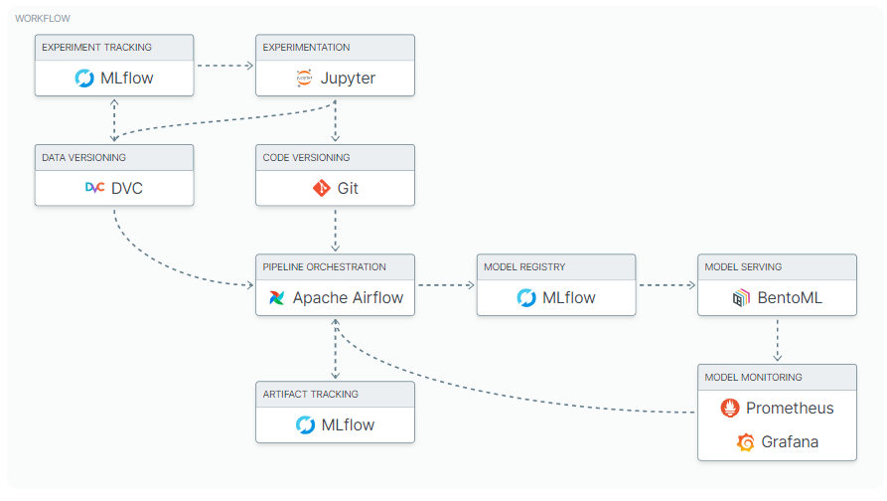
Example stacks

Slide 42
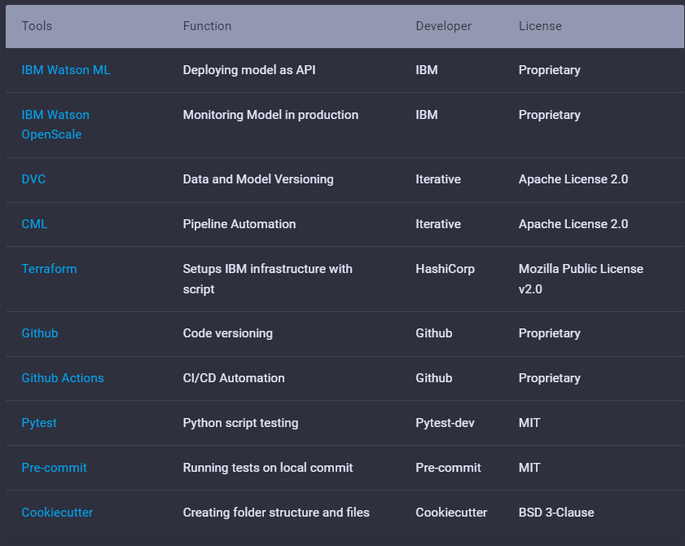
Example stacks

Slide 43
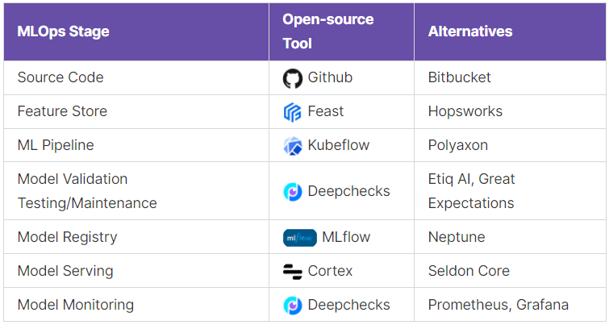
Example stacks

Slide 44
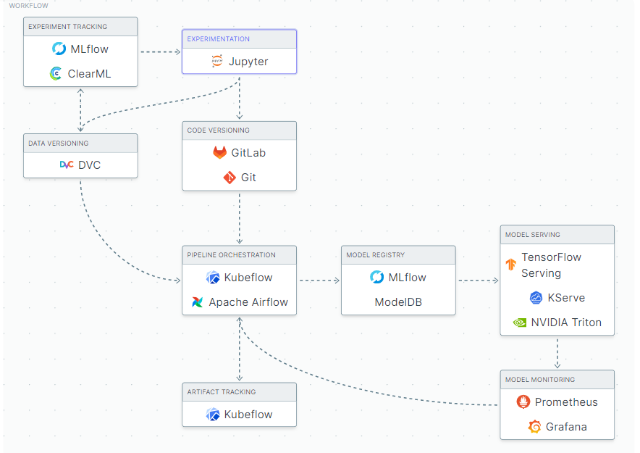
Example stacks

Slide 45
Example stacks
Gathering and analysis data: Apache nifi
End-to-End Platform for Continuous ML: ClearML (Alegro)
Monitoring: Promatheus, Graphanan, ELK Stack

Slide 46
Thanks!
Any questions?

